Slide 1
Bone and Joint Infections
Mohamed Elemraid
Paediatric SpR/ ID and Immunology
25 June 2012

Slide 2
Outline
Background
Management guidelines
Interactive cases

Slide 3
Risk Factors
Trauma (can be minor)
Immuno-deficiency
Sickle cell disease
Penetrating wounds
Bone fixators /plates
Varicella infection
Manual of Childhood Infections. RCPCH 2011

Slide 4
Clinical Features
Neonate
Young/older child
Irritability
Systemic symptoms
Pseudoparalysis
Widespread pain
Fever/temp instability
Bone/limb swelling
Erythema
Refusal to weight bear
Limping
Pain more localised
Fever
Bone/limb swelling
Erythema

Slide 5
Causative Pathogens
Common
  Staphylococcus aureus (MSSA), 44–80%
  Kingella kingae, 14–50% (increased <36 months)
Rare
  MRSA, 40–50% in USA, rare in UK
  PVL MSSA
  Group A Streptococcus (GAS)
  GBS, E coli (neonates)
  Non-typeable Haemophilus spp.
  Haemophilus influenzae type b (non-immunised or immunodeficient)
  Streptococcus pneumoniae
  Coagulase negative staphylococcus (sub-acute)
Faust et al. Managing bone and joint infection in children. ADC 2012

Slide 6
Age-specific Organisms
Neonates | GBS, MSSA, E coli and other gram negatives, Candida albicans
<2 years | MSSA, K kingae, S pneumoniae, H influenzae type b
 | Non-typeable Haemophilus spp., E coli, MSSA PVL
2–5 years | MSSA, K kingae, GAS, S pneumoniae, H influenzae type b
 | Non-typeable Haemophilus spp., Pseudomonas spp.
 | Coagulase negative staphylococcus (sub-acute), MSSA PVL
>5 years | MSSA, MSSA PVL
Faust et al. ADC 2012

Slide 7
Investigations
Blood
  FBC, CRP (+/- ESR)
  Blood culture (4 mL, unless neonates 2 mL)
Imaging: SA
  USS
  Consider bone scan
Imaging: OM
  MRI (gold standard)
  USS (if no urgent MRI and expertise available)
  X-ray (baseline)
Faust et al. ADC 2012

Slide 8
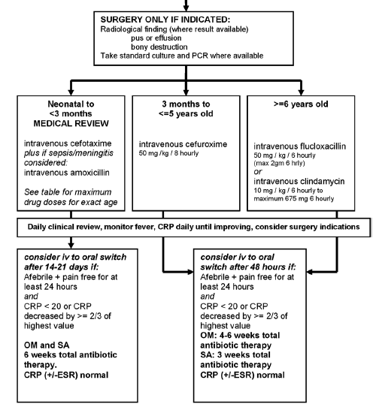
Management
For complex/multifocal disease:
Consider 2nd line Abx
At least 2/52 IV Abx (3/52 for neonate)
Longer oral therapy

Slide 9
Oral Antibiotic Choices
1–2 months | Co-amoxiclav
2 months – 5 years | Co-amoxiclav or Augmentin Duo
6–8 years | Co-amoxiclav or Augmentin Duo or Flucloxacillin
9–18 years | Flucloxacillin or Clindamycin
Faust et al. ADC 2012

Slide 10
JS
10 month boy
Normally well, born at term
PC: 2/7 right wrist swelling with reduced movement
  holding Rt hand in flexed position
  crying on attempting to move it
Off feeds for 3/7
Afebrile
Reviewed in A&E. X-ray NAD - home

Slide 11
Re-presented the following day:
Worsening swelling, redness and warm
Afebrile
WCC 18, Neut 10.8, CRP 21, ESR 27
IV Fluclox started, prior to wrist aspiration (not NBM)
?reaction to Fluclox, switched to IV Clindamycin
Blood Culture – Staph. epidermidis
Wrist aspiration (cloudy) – no growth
Remained well, afebrile
48 hrs IV Abx, then home with 3 weeks oral Clindamycin

Slide 12
Progress
2-week OP review:
Improving, moving Rt hand
WCC 18, Neut 6.8, CRP 10
Represented at 3 weeks:
‘Worse with development’
Crying ++, flopping to right in high chair, not sitting
1 kg weight loss, afebrile
3/7 watery diarrhoea
Investigations:
WCC 10.3, Neut 2.5, Lymph 6.2, CRP 22, ESR 31
Clostridium perfringens in stool
Blood culture – no growth

Slide 13
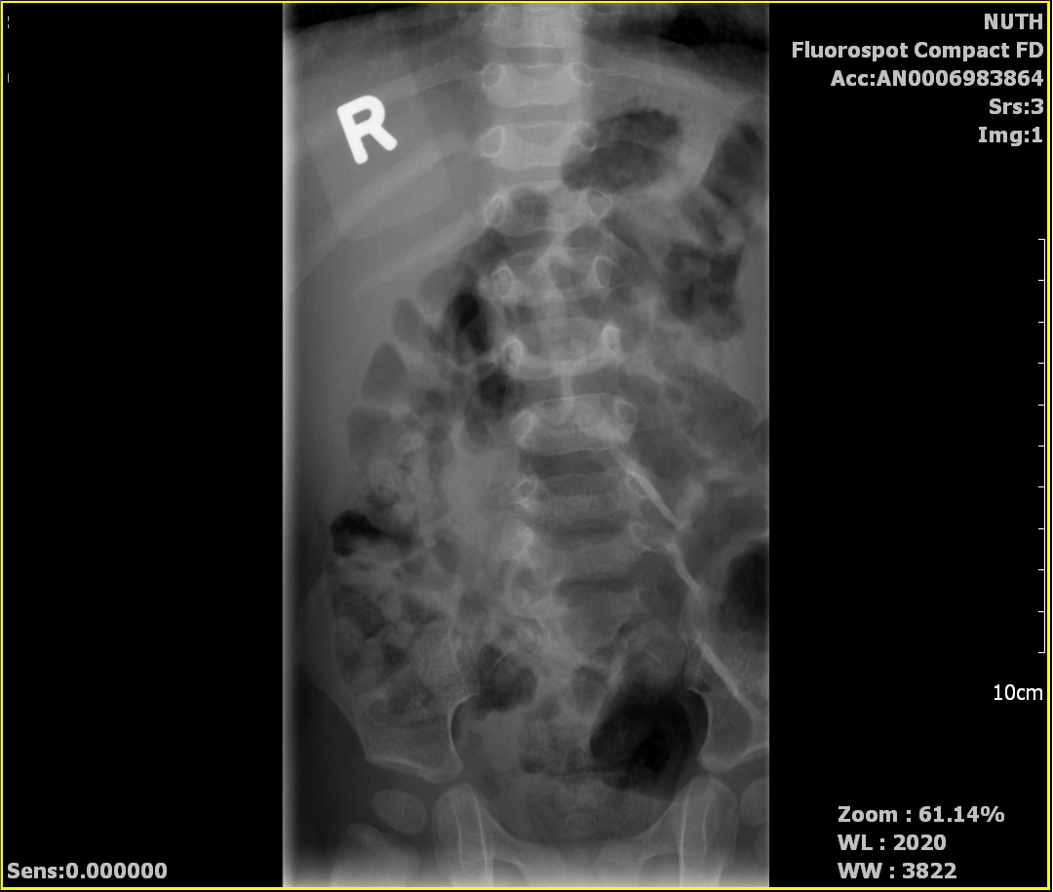

Slide 14
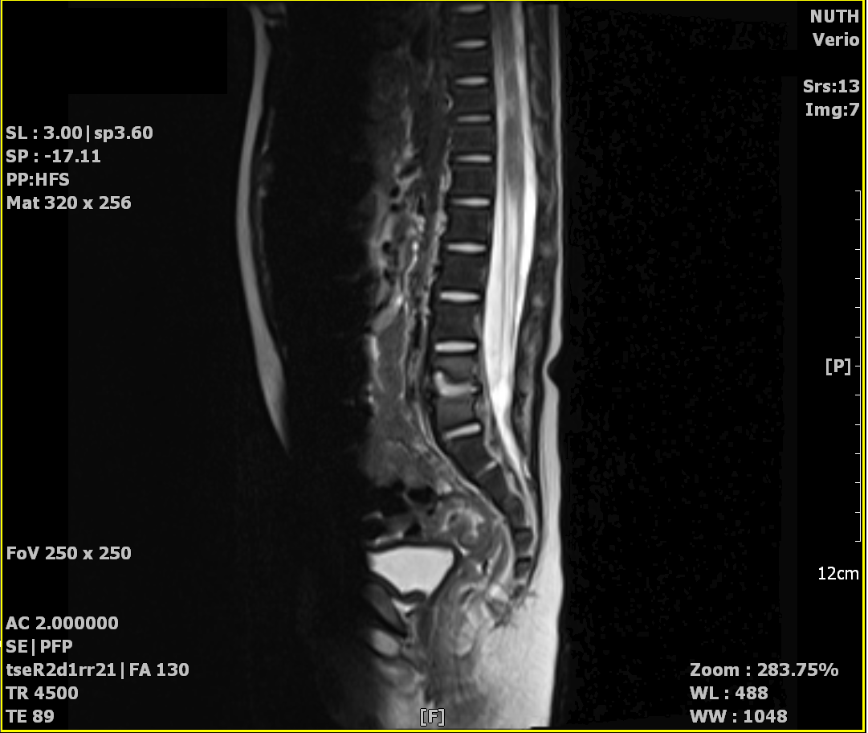

Slide 15
Imaging
X-ray spine
“Narrowing of intervertebral space L4/L5 with osteolytic changes. Normal vertebral alignment. Appearances are in keeping with spondylodiscitis.”
MRI spine
“There is evidence of discitis at the level of L4/5 with inflammatory changes at the adjacent endplates as well. There is no evidence of epidural abscess or thecal compression.”
MRI brain – normal

Slide 16
Further Investigations
Urine organic acids – normal
ASOT, anti-staphylolysin titre – normal
Quantiferon Gold – insufficient, Mantoux – negative
Neutrophil oxidative burst – normal
Nitro-blue tetrazolium – normal
Lymphocyte subsets – normal
Immunoglobulins – normal

Slide 17
Disc aspiration
IV Linezolid, IV Meropenem, PO Metronidazole
No growth on aspirate
13/4/12 (13 days post aspiration)
  Kingella kingae on PCR
PO Amoxicillin 250mg for 6-8 weeks
OP review at 8 weeks – back to normal

Slide 18
Kingella kingae
Recognised increasingly in young children (14–50%).
Difficult to isolate on solid medium, mild clinical signs.
Ceroni et al 2010
  Children <4y admitted between 2007 and 2009 with suspected bone and joint infections (43 cases).
  28 cases (65%) identified organism, of which 23 K. kingae.
  Mean age 19.6 months.
  Gram stain and isolation methods negative for all cases,
  subsequently detected as K. kingae by RT-PCR, specific to its RTX toxin.
  K. kingae:
    85% afebrile, 39% normal CRP, >90% normal WCC

Slide 19
JA
18 month boy
Term, developing normally and fully immunised
Dec 2010 (8 months)
  ENT OP for repeated ear infections
  Bilateral otitis media with effusion
April 2011
  7 episodes of ear infections over 4-5 months
  Bilateral grommets insertion

Slide 20
October 2011
Transferred from Wansbeck as ?septic arthritis
Temp 40
Swollen, red Rt ankle with reduced movement
CRP 401, WBC 24.8, Neut 19.5
Joint washout – pus
IV Cefuroxime

Slide 21
24 hrs later
Cultures (blood and aspirate)
  Streptococcus pneumoniae serotype 38
Changed Abx to high dose IV Amoxicillin
Repeated the joint washout
48 hrs later, difficult IV access
  PO Amoxicillin and IM Ceftriaxone
  After total 5/7 of IV/IM Abx – home to complete 6 weeks PO Amoxicillin

Slide 22
Further investigations
Immunoglobulins
  Low IgG
Complements
  absent CH100
  Classical complement pathway deficiency
    (C2 deficiency)
Commenced on prophylactic Amoxicillin 125mg BD

Slide 23
Summary
If there is a history of repeated infections, underlying pathology should be excluded e.g. immunodeficiency
If no response to treatment, consider unusual/less common pathogens
Role of PCR in identifying the causative pathogens

